Slide 1
DIGITAL TRANSFORMATION, SOCIAL MEDIA AND CONSUMER INSIGHTS
Dr. Ceren Kolsarici

Slide 2
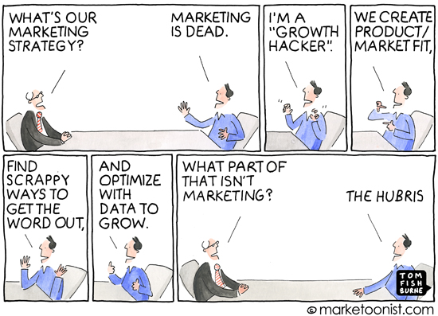
Marketing IS Growth Hacking
CODING + MARKETING
Term coined by Dropbox Alum, Sean Ellis.
DBs referral programs made up for 40% of its sign-ups
Immediately adopted by the Slicon Valley companies like AirBnb, Uber, Facebook
Focus on growth & virality by design
“Growth hacking threw out the playbook of traditional marketing and replaced it with only what is testable, trackable, and scalable. Its tools are emails, pay-per-click ads, blogs, and platform APIs…” Ryan Holiday, Author

Slide 3
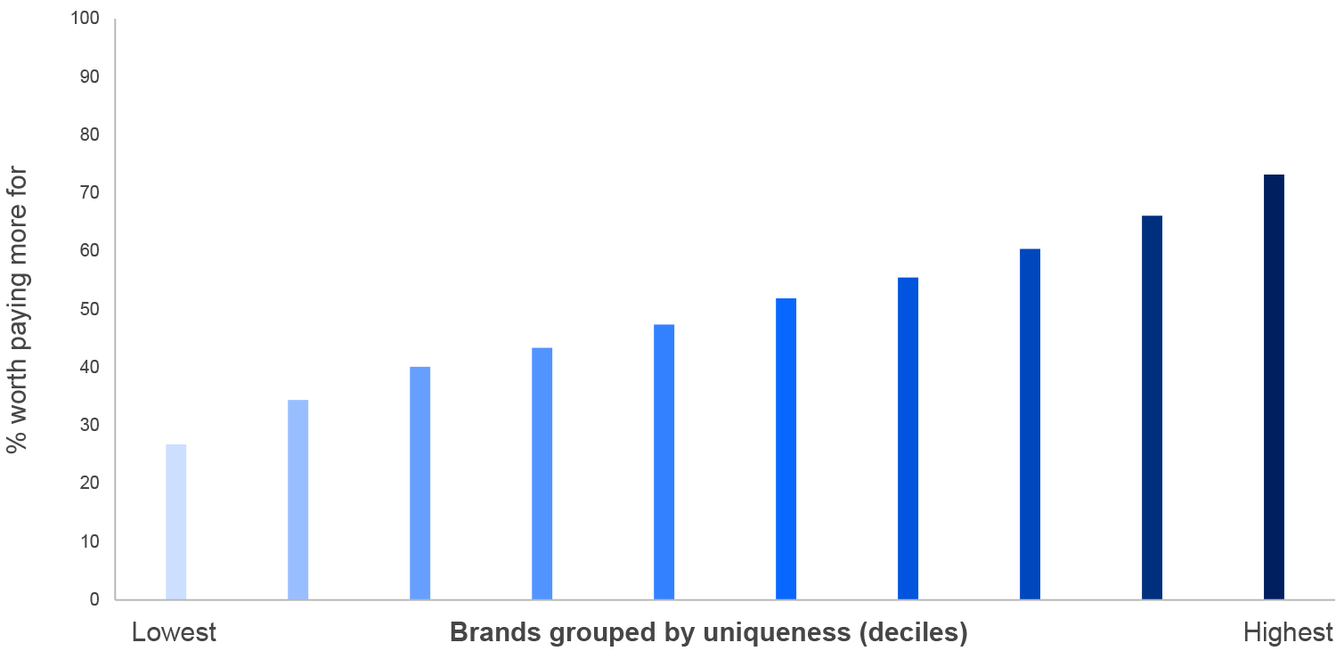
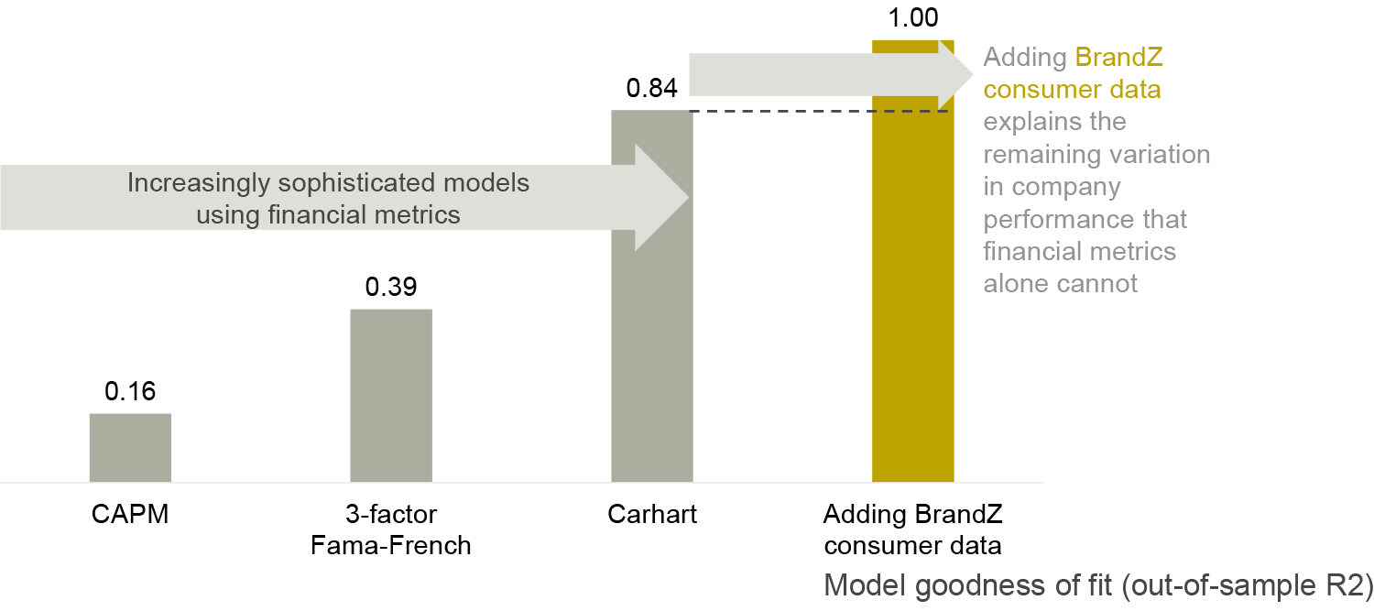
Growth Hacking Example: The REAL Impact of Marketing: Interactions & Brand Goodwill
Difference is worth paying for more
Analysis of 40K brands in the Kantar BrandZ database shows strong negative relationship between differentiated brand position and price sensitivity.
Source: Kantar Media
Analysis of 872 brands over 12 years: Brand Difference is the biggest contributor towards abnormal stock returns.
Source: Said Business School, Oxford
Notes:
https://www.kantar.com/inspiration/brands/is-brand-differentiation-an-effective-way-to-reduce-customer-price-sensitivity?utm_source=linkedin&utm_medium=social

Slide 4

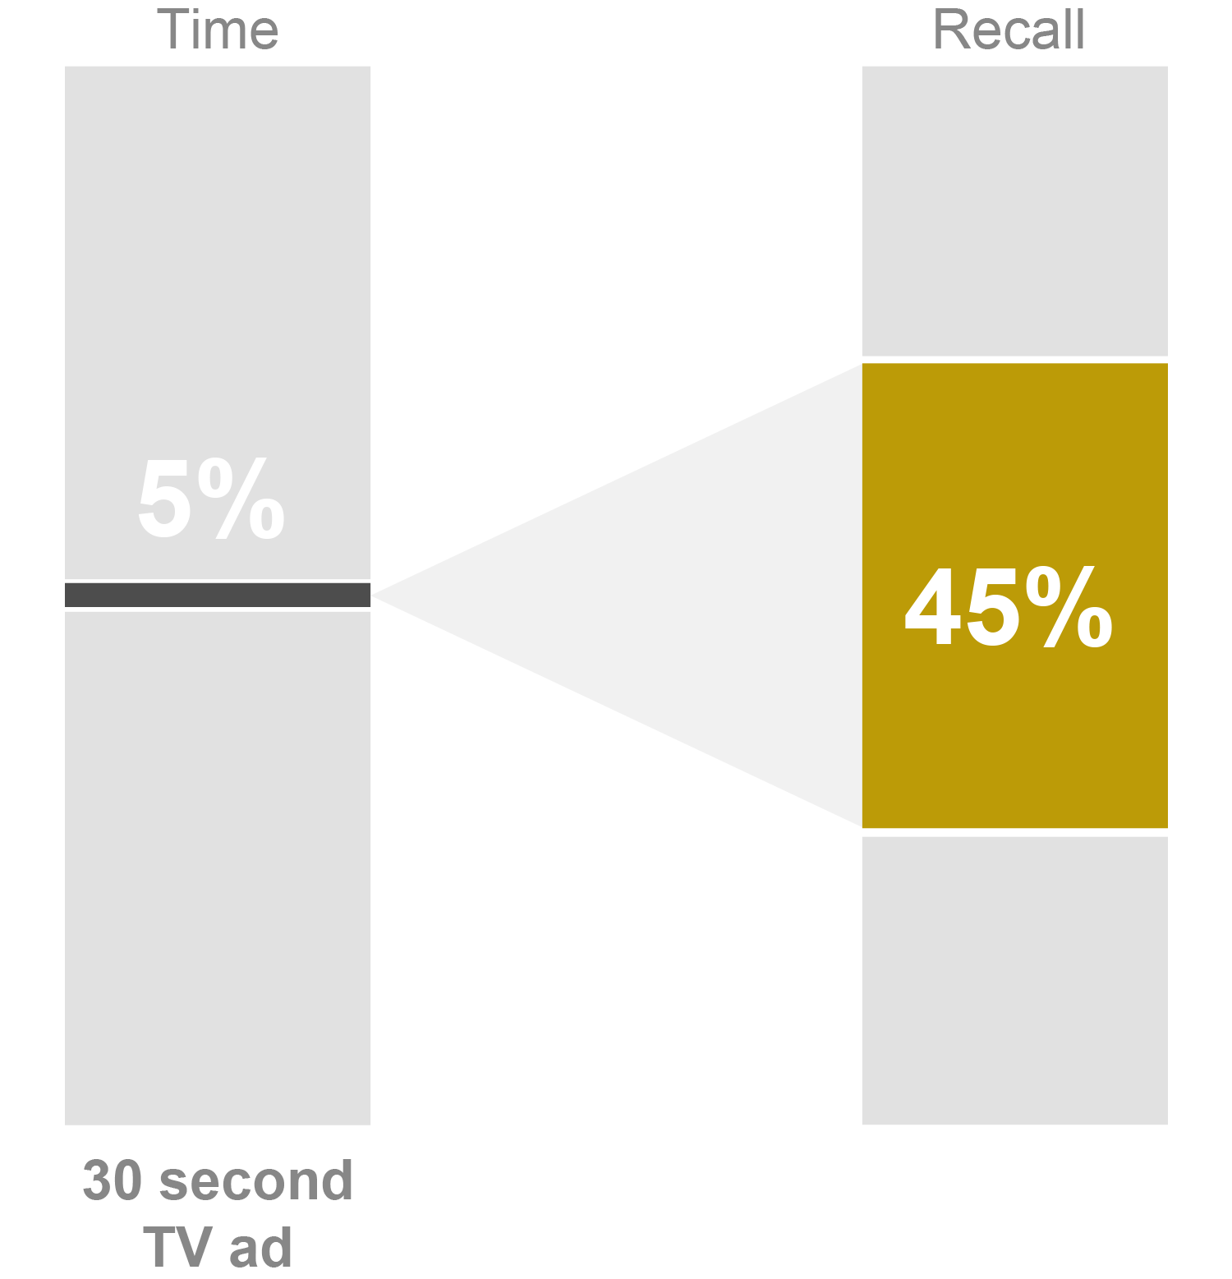
Growth Hacking Example: The Secret to Good Branding is Advertising
Winner of Kantar Creative Effectiveness Awards (2021)
5% of the ad creates 45% of the recall
*Out of 13,000 ads tested
Freshness injected into brand heritage while still adhering to its distinctive values
Good branding is not about showing the brand first in the TV ad but a well-integrated story with distinctive branding coming at the most memorable moment.

Slide 5
THE FUTURE OF MARKETING
DIGITALIZATION

Slide 6
INDUSTRY 4.0
Consumers expect interactive and personalized experiences thanks to
Social
Mobile
Analytics
Cloud
Digital Enterprises
Leverage SMAC to optimize cost, increase productivity, digitize operations, and become truly customer centric.
Source: https://www.smarterchains.com/industry-40-is-now

Slide 7
Growth in Global Digital Advertising
Eye-tracking technology shows that only 18% of viewable ads are looked at, and only 5% for more than a second. Why?
Persuasion knowledge → Ad Avoidance
Source: Statistica

Slide 8
How Spending aligns with Media Consumption
Media Ranked by Gap in Consumer Time Spent and Ad Spent ($)
Under-spent
Over-spent
-Social media (linear TV) would need to reduce by $94.3 ($86.9) Bl. order to mirror global consumption levels in 2022
- Social media over-weighting is dramatic worldwide but it is significantly heavier in US
Source: WARC, GWI. Base = survey of 715,000 consumers worldwide, March 2021
Notes:
(Worldwide Advertising Research Center) and GWI (Global Web Index) have released findings of a global study of consumers purporting to show the ad spending gaps across media, as well as international markets.

Slide 9
Advertising v. sales promotions
Long-term v. Short-term Impact

Slide 10
CONSUMER PRIVACY
WHAT IS CHANGING IN AD MEASUREMENT?

Slide 11
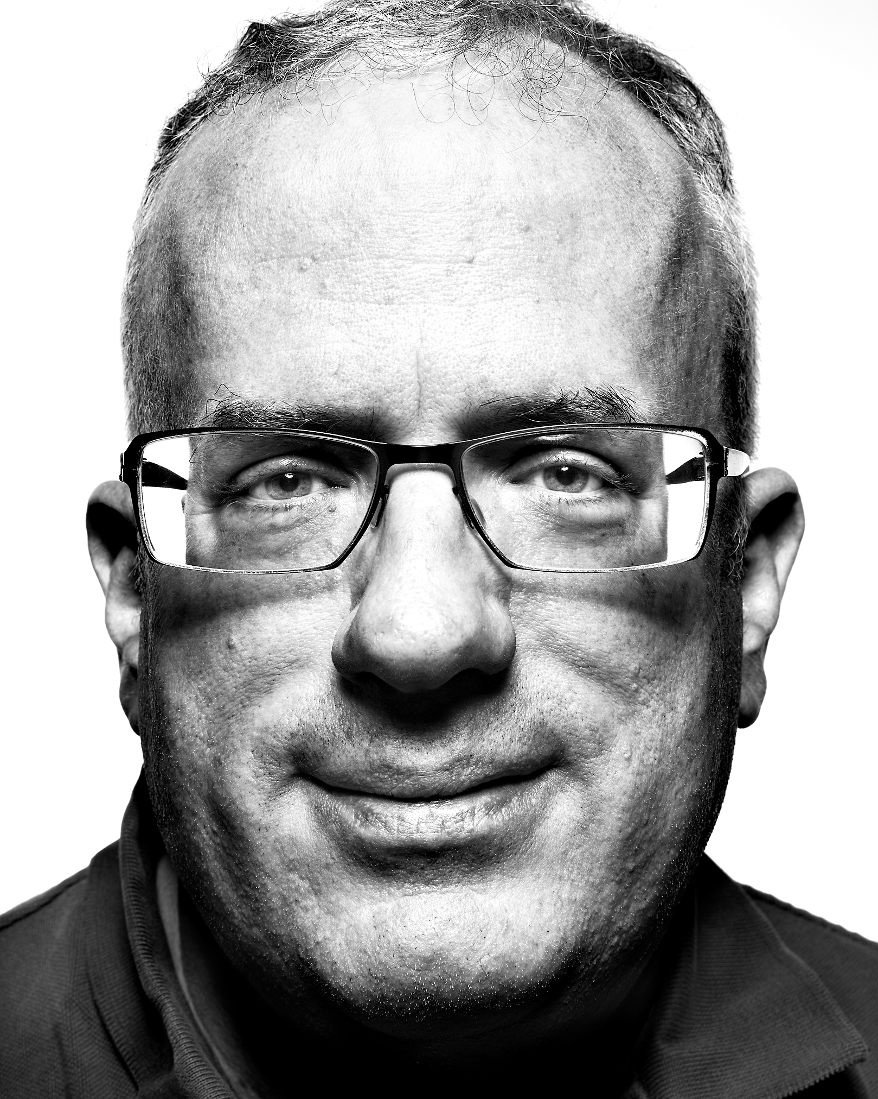
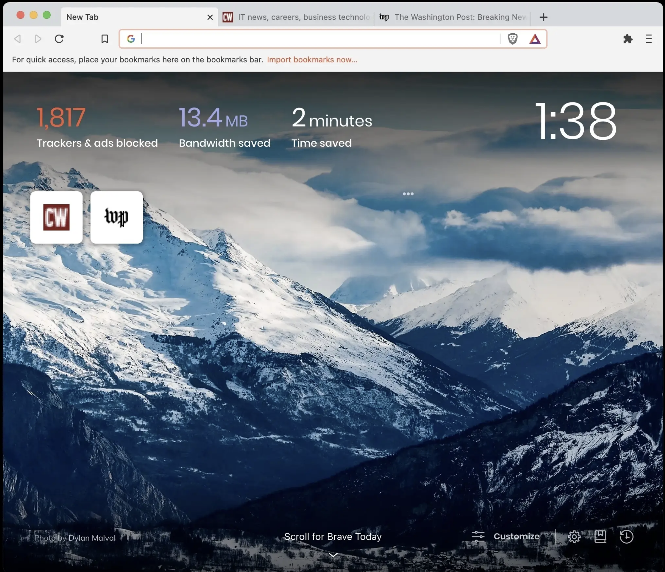
“Change is the only Constant,” Heraclitus
Brendan Eich – creator of JavaScript, co-founder of Firefox founded a Blockchain startup: BRAVE
Notes:
Blockchain StartUp
The web browser from Brave Software relies on an unusual business model: it strips out ads from websites, replaces them with its own ads, then allows users to send money to sites they like
Faster b/c it eliminates ads (downloads less data). Loads 3 times faster than google.
Eliminates Ad Trackers, blocks efforts by advertisers to first identify users, then follow those users. That makes Brave users more anonymous
Does not store data.

Slide 12
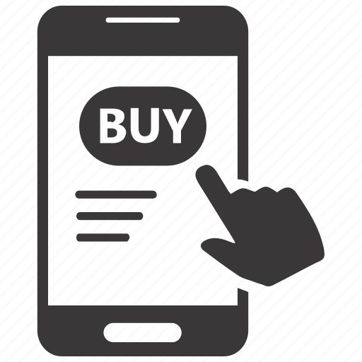
BRAVE Blockchain Browser and BAT (Basic Attention Token)
Change the way users interact with ads
Break up the current monopoly on digital advertising by allowing publishers and advertisers to trade on the value of users’ attention
Compensate users using the BAT token
Users get to choose which ads they like and opt-in to categories they like
WIN-WIN
→ Marketers get better advertising data and targeting,
publishers get better revenue and control over the ads they display
Users get fewer, better quality ads, and they get compensated for their attention and data, and their data is encrypted in the blockchain

Slide 13
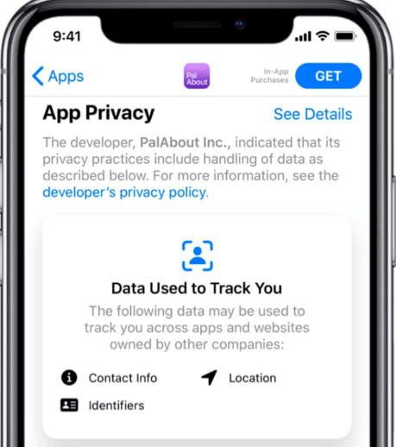
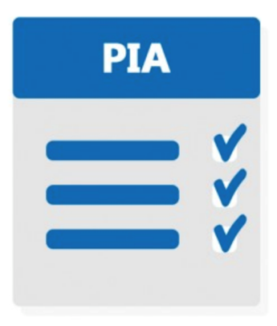
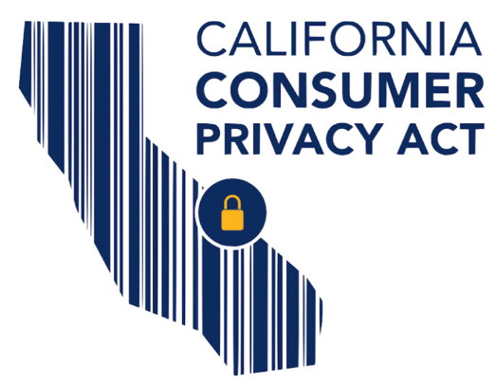
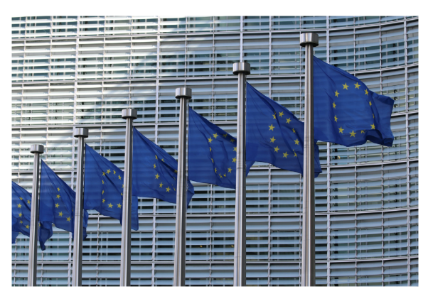
Timeline of Data Privacy
2002 2012 2018 2020 2021
According to the GDPR, organizations must provide people with a privacy notice that is: In a concise, transparent, intelligible, and easily accessible form. Written in clear and plain language, particularly for any information addressed specifically to a child. Delivered in a timely manner.
Source: https://safecomputing.umich.edu/privacy/history-of-privacy-timeline

Slide 14
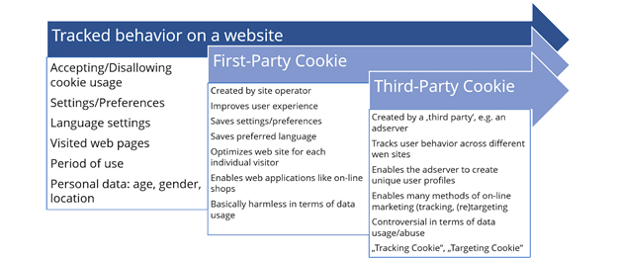
Tracked Behavior on a Website

Slide 15
Privacy Concerns Impact Some Areas More than Others
Becoming Obsolete
Still in Play
Conversion tracking by ad platforms
Programmatic display ad measurement
Profiling and targeting
Frequency capping
Remarketing
Search ads
Platforms with first-party data can still deliver targeted ads
Advertisers’ use of first-party data
First-party cookies on your own websites (e.g. Google’s customer match, FB’s custom audiences)

Slide 16
Ad Measurement in a Privacy-First Future
Proposed Solutions
Server-to-server Tracking connects ad platforms’ and advertisers’ servers without the need for browser- or device-based tracking (e.g. Facebook’s Conversion API, Google's server-side tagging)
On-device privacy-enhancing technologies (PET) where processing happens on the user’s device and data is shared back in a privacy-safe manner (e.g. Apple’s browser events like Private Click Measurement and App events like SKadNetwork, Google’s Privacy sandbox)
Or…

Slide 17
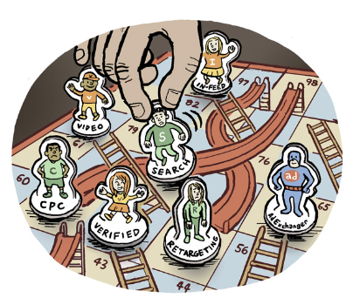
Attribution game

Slide 18
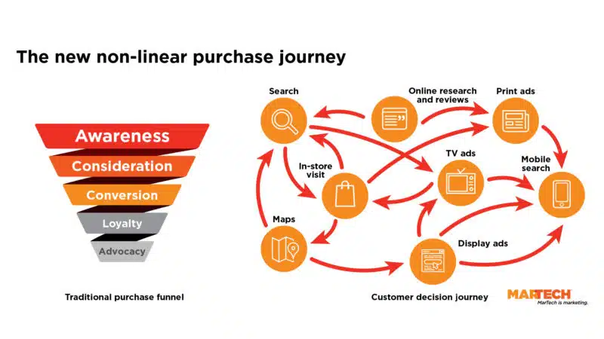
Three Trends Precipitating the Need for More Sophisticated Media Assessment
The need to measure and optimize for ROI in both performance and brand spend
Adapt to the declining availability in the event-level data due to privacy related considerations
Capture complexities of digital media while incorporating traditional media such as linear TV
Nonlinear

Slide 19
Attribution is Challenging both in Theory and Practice
A & AI can resolve the long-debated attribution problem
If you divide your advertising and promotion budget across multiple touchpoints, which ones get the credit? What percent of the credit should they get?
In the real world, there’s no telling if people actually heard your radio ad, saw your television commercial, glanced at your newspaper insert, or noticed your poster on the side of a bus.
Online platforms allow us to capture so much information, stitching together the touchpoint interactions to establish bragging rights between marketing functions

Slide 20
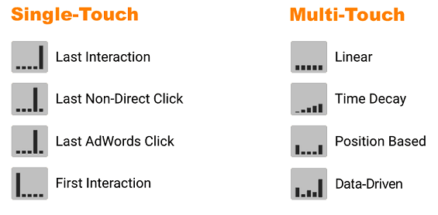
Google’s Attribution Models
Instead of rules based on conjecture, data-driven attribution has the ability to make decisions based on actual data
It is not wise to continue to invest in, execute and analyze digital marketing in a siloed channel-by-channel fashion.
Notes:
All are flawed! While each of these is well thought out, they are artificial and based on conjecture.

Slide 21
Attribution in a Privacy-First Future
Evaluate and adapt your current strategy
Methods like multi-touch attribution that are highly reliant on cookies and other mechanisms like mobile device identifiers may no longer be feasible
Shift to unaffected advertising media (contextual, CTV, retail media)
Consider existing privacy-conscious measurement methods
The good old Marketing Mix Modeling (MMM)
Combine experimental and observational data. Geo-experiments which measure incremental performance driven by ad exposure by comparing geographic-level data from test and control markets.
Brand lift which use polling to help understand the true value of your ad campaigns. Yet, such survey-based methods are prone to biases
Explore fresh, privacy-first solutions
The advertising ecosystem is not static. Closely follow innovation and be ready to adapt (e.g. Facebook’s Conversions API)

Slide 22
MMM is Taking Back the Spotlight
As the privacy and regulatory environment continuous to change, MMMs are once again becoming an increasingly important part of an effective measurement strategy
Tech giants recently launched open-source MMM tools
Facebook launched Robyn in 2020
Uber launched Orbit in 2021
Amazon launched automated MMM in November 2022 (not open source)
Google launched Meridian in March 2024
Why open source?
Encourage industry collaboration
Higher pace of innovation

Slide 23
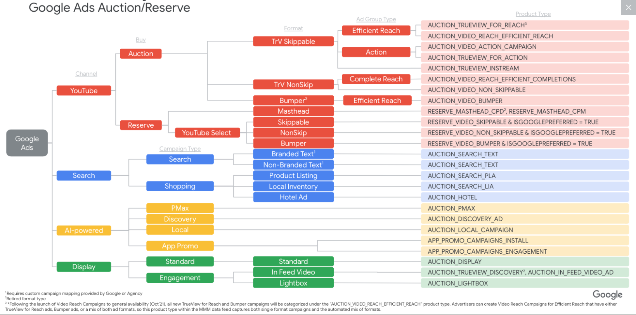
Data Schema for Meridian Data Platform
Reach and frequency data from YouTube, Gmail, Search (generic & branded), Google Maps, Google audience
Ability to link search to TV
Notes:
https://developers.google.com/meridian/docs/basics/using-mmm-data-platform

Slide 24
DIGITAL MARKETING
A FRAMEWORK

Slide 25
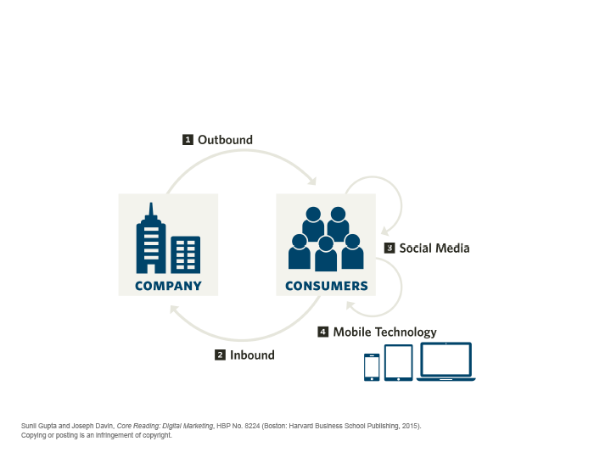

A Framework for Digital Marketing
Outbound marketing (aka push): Firms reach out to target consumers via traditional (e.g. print, radio, TV) or digital (e.g. search, display) channels.
Inbound marketing (aka pull): Consumer searches for the product or service and firms create presence to be top of mind (e.g. SEO, blogs and podcasts, content marketing, apps)
Social media: Digital platforms where consumers actively create content (e.g. Yelp, IMDB, Twitter, IG, Facebook) to influence other consumers
Mobile technology: Connected anytime from anywhere
MSPs

Slide 26
BLOCKCHAIN
REFRESHER

Slide 27
How Blockchain can Help Digital Advertising
Data Collection and Privacy
Ad Fraud, Data Quality and Reporting
Ad delivery, frequency and timing
A descentralized unhackable database to which everyone has access to, eliminating the middle man.
What can blockchain record aside from financial transactions?
Ad delivered, Contract signed, Music Played

Slide 28
Ad Fraud and Blockchain
Total cost of ad fraud is predicted to increase to $100 billion in 2023 (from $81 billion in 2022)
Corresponds to 66% of Facebook’s ad revenue in 2022
56% of all ad dollars spent on display advertising was lost to fraudulent advertising in 2022
Non-human traffic, bots
The biggest advertisers like P&G cut their digital ad budget because their agencies could not provide the transparency and accountability needed
Blockchain → Make advertising more transparent by validating and analyzing every consumer’s journey through verified ad delivery, confirming a real person and not a bot saw the ad.
No more underestimating digital ad ROI
Better tracking and attribution of digital spending
Source: Statistica

Slide 29

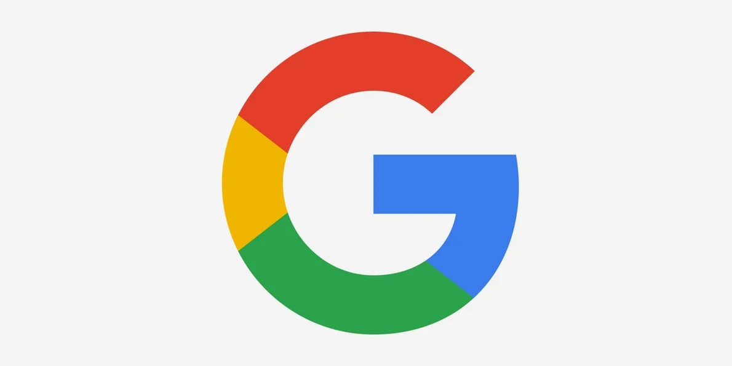
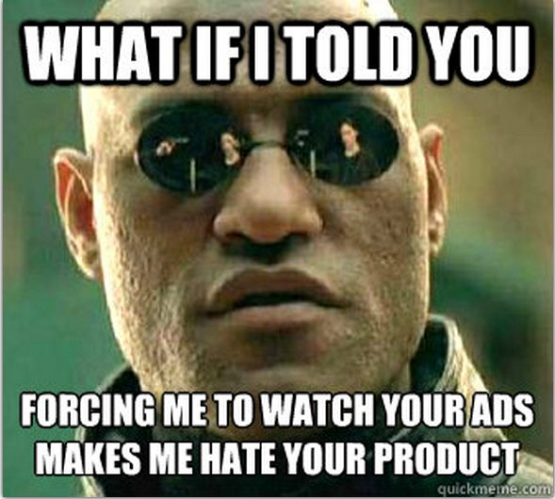
Display Ad Efficiency
Consumers hate ads they don’t want to see and like the ones that are actually useful (??)
Display ads are intrusive, annoying and universally hated
Industry is monopolized by two providers:
“Let’s throw it at the wall and see what sticks” approach no longer works
(Yes, the wall is you!)
Same display at thrown at you at all websites, even though you’ve made a purchase for that product two days ago.
Blockchain → Ensuring the optimal frequency of ad serving for each customer for each product
No more overexposure beyond saturation point

Slide 30
Data Collection and Privacy
To access the internet, consumers go through traditional gatekeepers such as ISPS, web browsers, social media platforms
Learn almost everything we do online, sites, content, conversations
How much can we trust these companies to protect our data?
Not much! See Cambridge Analytica, Trump campaign in US elections
Blockstack→ a new internet for decentralized apps. Your personal data remains with you instead of existing with a platform or on the cloud
→ Visiting a site or using an app is similar to inserting a key into a lock. You can take it out anytime you want
→ Gives data ownership back to the user

Slide 31
SEARCH ENGINE MARKETING
OUTBOUND MARKETING

Slide 32
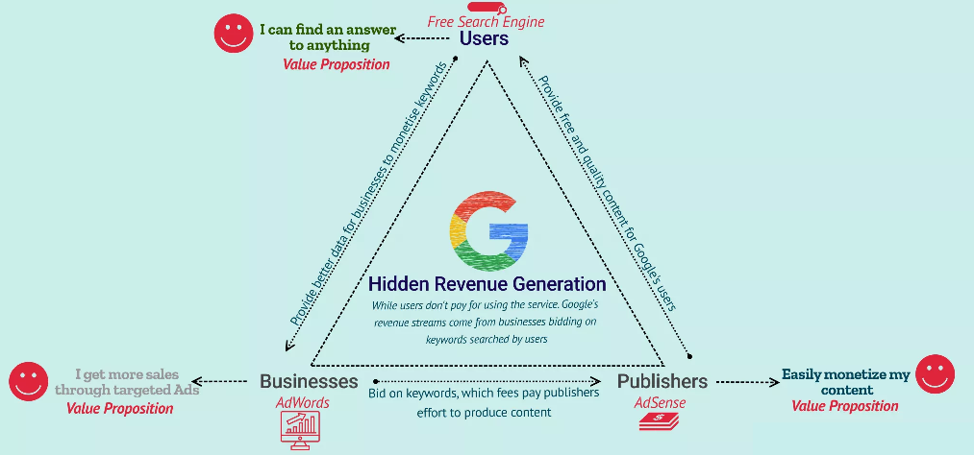
Google's 2020 Revenues > $180 B
And yet it is FREE
Win-Win-Win Advertising Model

Slide 33
Increasing Presence in Search Platforms
Organic SEM (SEO)
Reverse engineer Google's complex algorithm to score higher and achieve higher rankings
Obtain a relevant inbound link: Get indexed
Optimize meta tags
Increase prominence: Cross-linking to improve visibility, writing content including popular keywords
Paid-Search Advertising
Search engine marketing focuses on paid search
Search engine optimization focuses on organic search

Slide 34
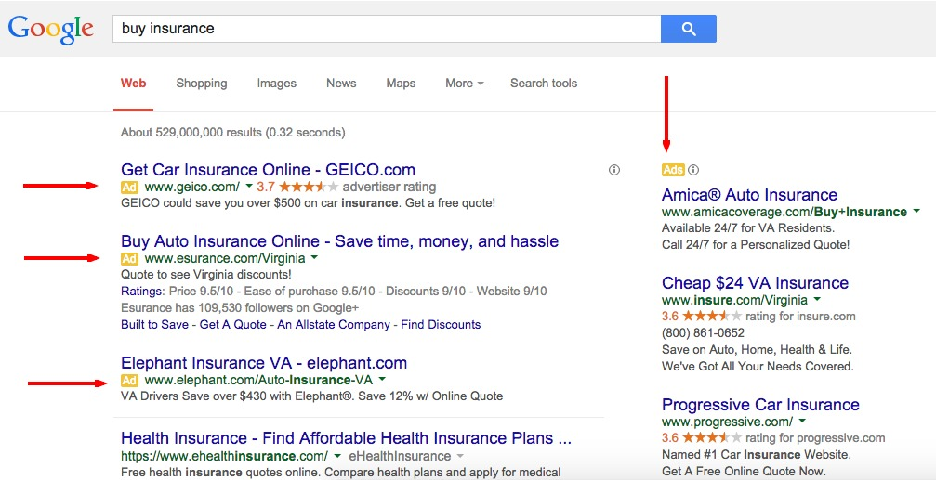
Paid Search Advertising
Google Ads (Paid)
Organic
Results (Unpaid)

Slide 35
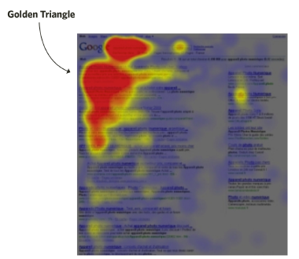
Golden Triangle for Search Engine Results
19%
75% of eye activity
6% of the eye activity
Source: https://miratech.com/blog/eye-tracking-google1.html

Slide 36
AdWords is Google’s Main Source of Revenue
Google searches are free! So how does google make money?
PPC, CPM, Ads (i.e. targeted banner, text and rich media ads)
Google has two platforms for advertising:
The Google Search Network, featuring the standard Google Search, Google Shopping, Maps and its various search partners.
Google Display Network, which is any website that partners with Google, and other Google sites such as Gmail, YouTube and Blogger.
AdWords works via a bidding mechanism (both CPM & CPC)
Manual bidding: clients choose bidding amounts
Automatic bidding: Google chooses the bid within your budget

Slide 37
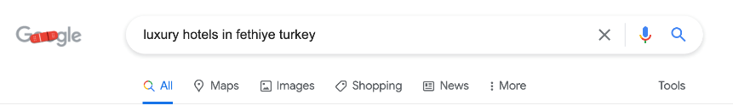
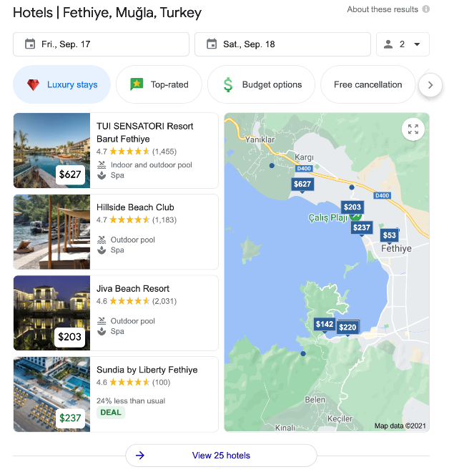
Two sides of Paid Search
Consumer Perspective
Firm’s Perspective
Keyword
Impression
Click/Landing
Conversion
CIAO!
Which keywords should the firm pay for? What are some drivers of that decision?

Slide 38
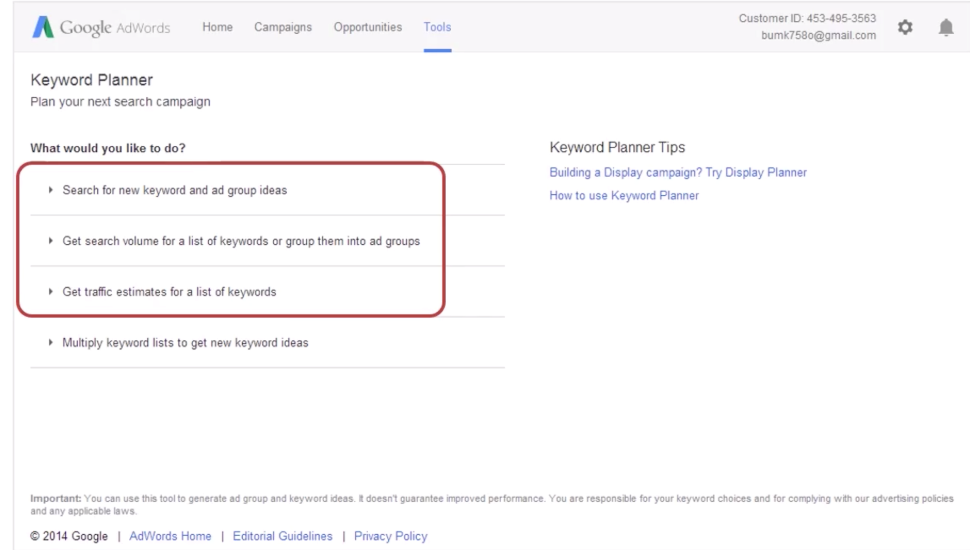
How to Choose a Keyword?
Demand?
Cost?
Anything else?

Slide 39
What does the Cost of a Keyword depend on?
Luxury Beach Resort
VS
Luxury Beach Resort in Fethiye Turkey
Long Tail Keywords
# of Keywords
Notes:
The long tail of the search Demand Curve

Slide 40
How does Paid Search Advertising Work?
Advertisers place bids for different queries in an auction.
Based on bids and quality score (fit of advertiser and ad to the queries), Google decides price-per-click (PPC) of each advertiser and each query.
Each advertiser also specifies a budget. Each time user clicks on advertiser's ad, budget is depleted by PPC amount
Advertiser only pays Google if the user clicks on the ad. The probability that a user clicks on an advertiser's ad is the click-through rate (CTR)
Google then decides how often to display each ad for each query.

Slide 41
Google AdWords (continued…)
AdWords works well!
40% of consumers are unaware that Google Adwords are adverts.
Google updated AdWords with Enhanced Campaigns.
This means advertisers can now target people based on time of day, location and the device they're using.
Notes:
The faint cream of the paid search box means that users may easily ignore organic search results further down, depending on the quality of their screen (or eyesight).

Slide 42
Benefits of Using Paid Search
The client appears at the top of the SERPs.
With organic results decreasing rapidly further down the screen, it's vital that your company appears within the top five results in order to stand a chance of click-through.
The results are quick:
If you have enough investment, PPC is the fastest way to get to the top.
The process is efficient:
If you know your way around the platform, you can set up a PPC campaign in less than an hour, and appear immediately in the sponsored results.
Attribution is feasible:
Tracking is a lot easier using SEM. Every ad, keyword and penny spent can be tracked, allowing for a more accurate ROI. It's a lot easier for an advertiser to test campaigns (e.g. randomized field experiments).

Slide 43
Example: Paid-Search Advertising
Click-through Rate
Advertiser | Query 1 ("4G LTE") | Query 2 ("largest LTE") | Query 3 ("best LTE network"
AT&T | 0.10 | 0.10 | 0.08
T-Mobile | 0.10 | 0.15 | 0.10
Verizon | 0.10 | 0.20 | 0.20
AVERAGE PRICE PER DISPLAY
Average amount that an advertiser pays each time its ad is shown is: PPC x CTR
Notes:
50 users x 0.08 = 4 users
100 users x 0,08 = 8 users

Slide 44
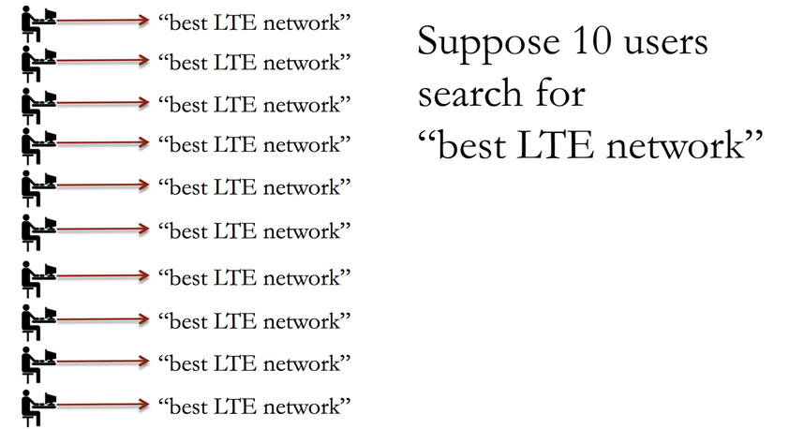
Example: Paid Search Advertising

Slide 45
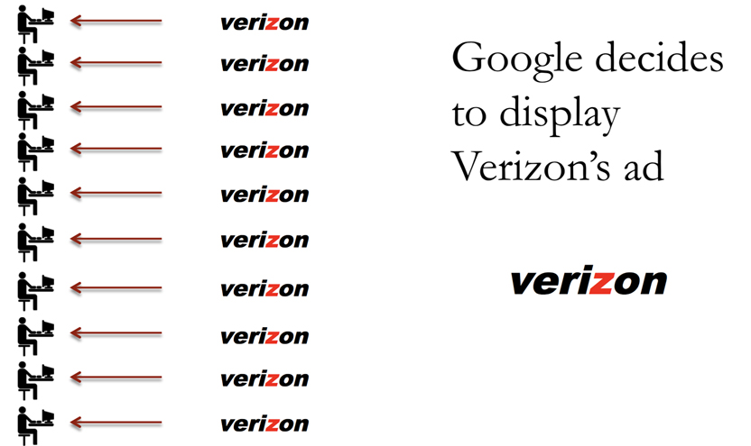
Example: Paid Search Advertising

Slide 46
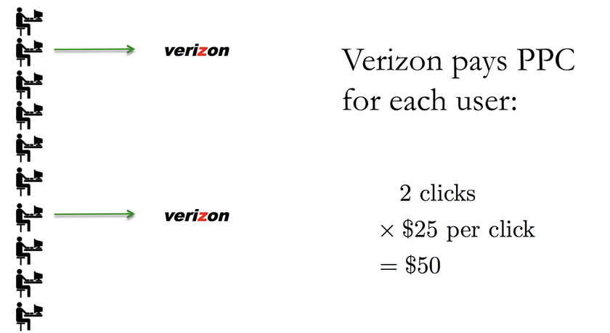
Example: Paid Search Advertising
TOTAL VERIZON SPENDING

Slide 47
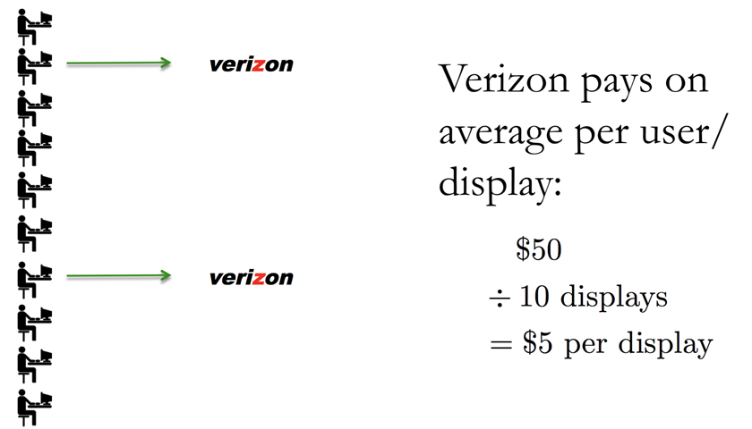
Example: Paid Search Advertising
VERIZON AVERAGE PRICE PER DISPLAY (APPD)

Slide 48
Putting It All Together
 | Advertiser | Query 1 ("4G LTE") | Query 2 ("largest LTE") | Query 3 ("best LTE network"
PPC | AT&T | $5 | $5 | $20
 | T-Mobile | $10 | $5 | $20
 | Verizon | $5 | $20 | $25
CTR | AT&T | 0.10 | 0.10 | 0.08
 | T-Mobile | 0.10 | 0.15 | 0.10
 | Verizon | 0.10 | 0.20 | 0.20
APPD | AT&T | $0.50 | $0.50 | $1.60
 | T-Mobile | $1.00 | $0.75 | $2.00
 | Verizon | $0.50 | $4.00 | $5.00
Google does not control how many times a query will be requested – driven by users!
For each query, Google has estimate of number of times query will be requested over a given day.
Query | Est. # of Requests
"4G LTE" | 140
"largest LTE" | 80
"best LTE network" | 80

Slide 49
HANDS ON EXERCISE
OPTIMAL REVENUE PROBLEM FOR GOOGLE

Slide 50
Modeling Google's Problem
Objective:
Maximize revenue
Decision:
For each advertiser and query, number of times ad will be displayed for that query
Constraints:
Average amount paid by each advertiser cannot exceed budget
Total ads for given query cannot exceed estimated number of requests for that query
How many times to display each ad for each query to maximize revenue?

Slide 51
Problem Data
 | Advertiser | Query 1 ("4G LTE") | Query 2 ("largest LTE") | Query 3 ("best LTE network"
APPD | AT&T | $0.50 | $0.50 | $1.60
 | T-Mobile | $1.00 | $0.75 | $2.00
 | Verizon | $0.50 | $4.00 | $5.00
Query | Est. # of Requests
"4G LTE" | 140
"largest LTE" | 80
"best LTE network" | 80
Google does not control how many times a query will be requested – driven by users!
For each query, Google has estimate of number of times query will be requested over a given day.
Advertiser | Budget
AT&T | $170
T-Mobile | $100
Verizon | $160

Slide 52
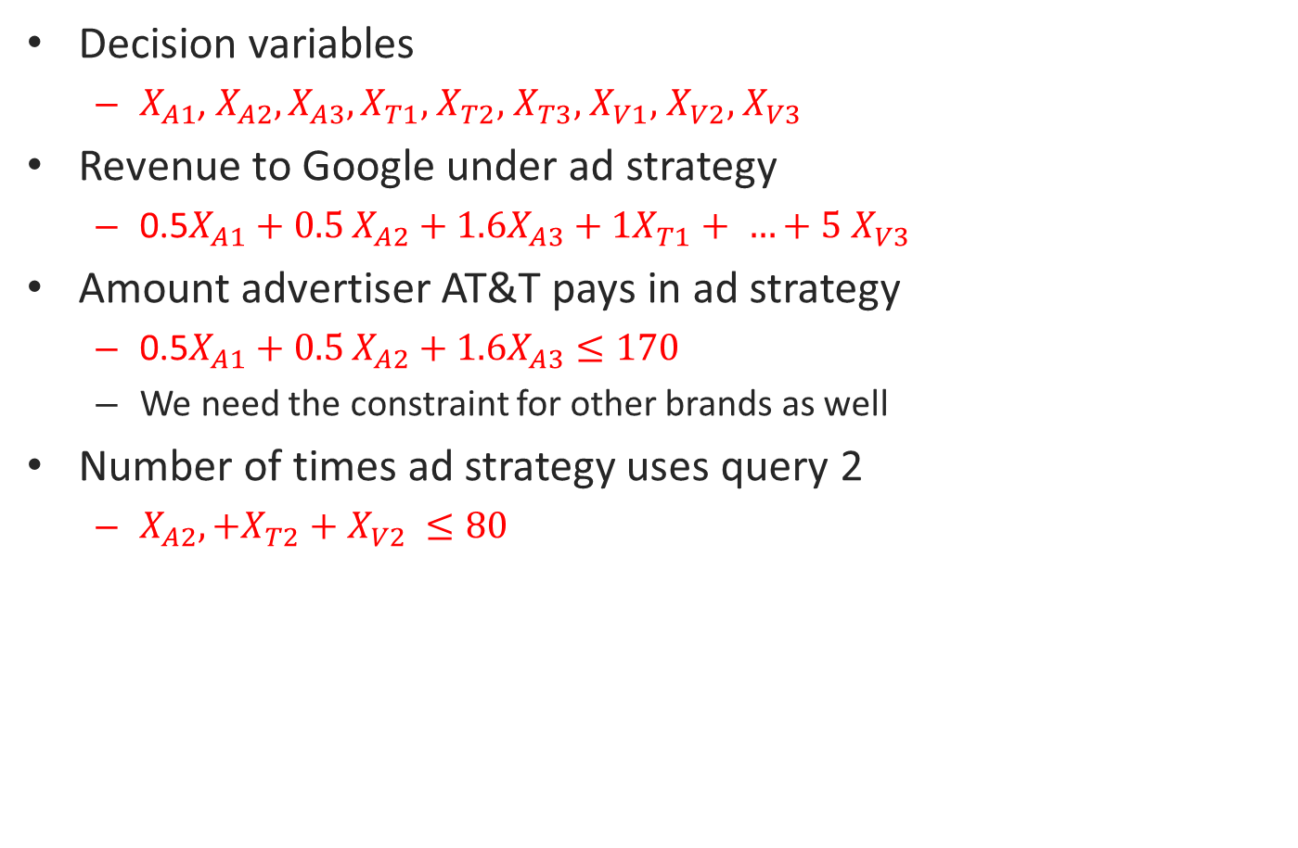
Modeling the Problem
Decision variables
$X_{A1}$, $X_{A2},X_{A3},X_{T1},$ $X_{T2},$ $X_{T3},$ $X_{V1},$ $X_{V2},$ $X_{V3}$
Revenue to Google under ad strategy
0.5$X_{A1}+0.5$ $X_{A2}+1.6X_{A3}+1X_{T1}+ …+5$ $X_{V3}$
Amount advertiser AT&T pays in ad strategy
0.5$X_{A1}+0.5$ $X_{A2}+1.6X_{A3}≤170$
We need the constraint for other brands as well
Number of times ad strategy uses query 2
$X_{A2},+X_{T2}+X_{V2} ≤80$
LET'S SOLVE THIS LINEAR OPTIMIZATION PROBLEM

Slide 53
Search roi

Slide 54
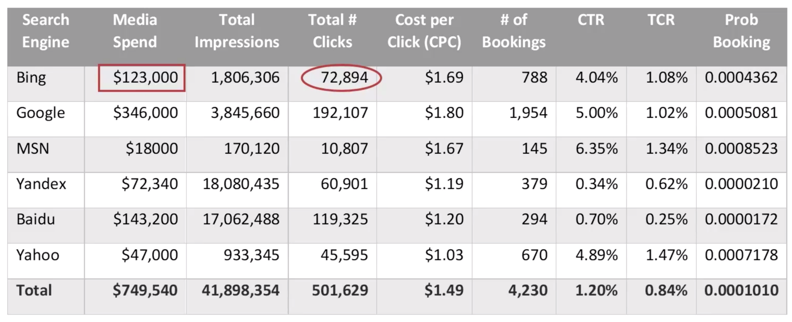
Search Campaigns for Liberty Hotels Lykia
Assume $1000 revenue from each booking, what’s Bing’s ROI?

Slide 55
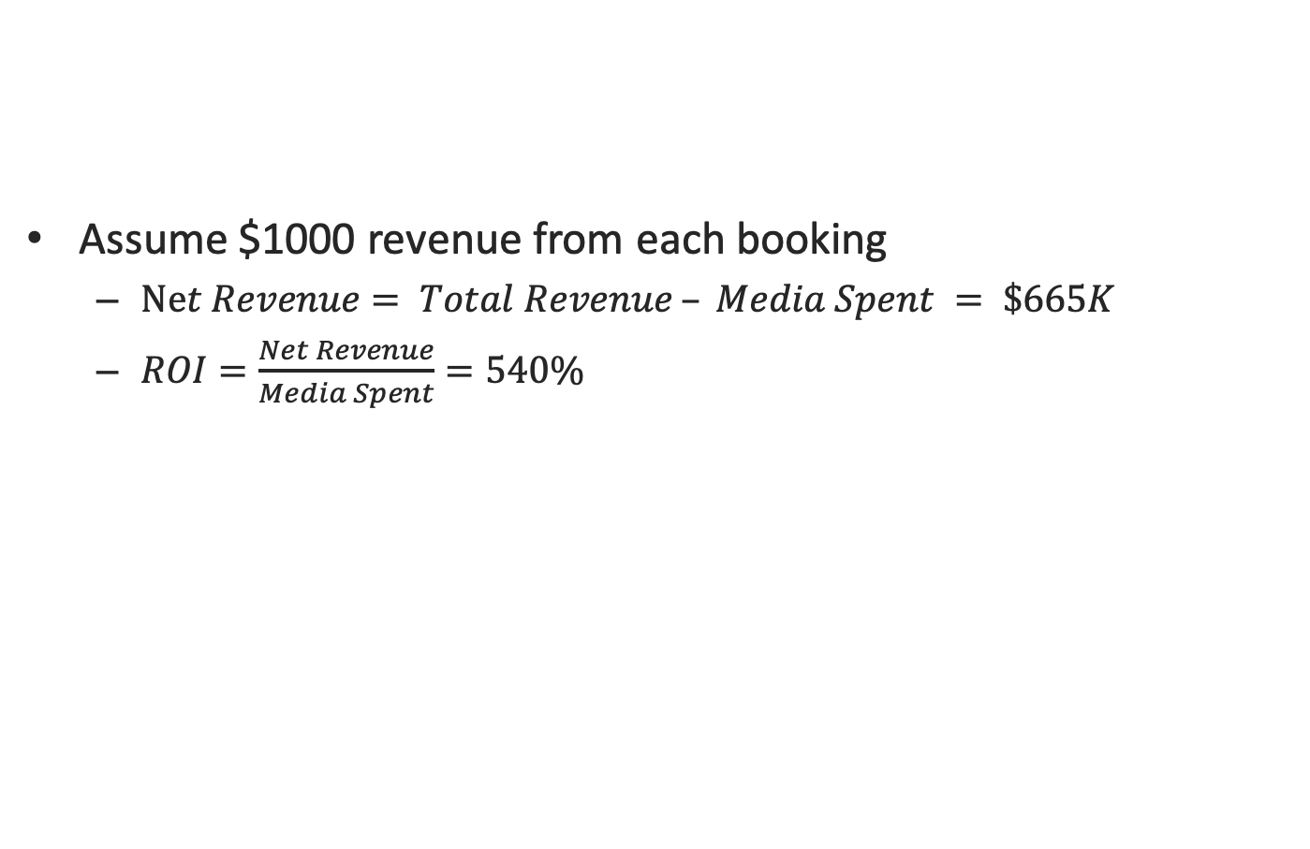
ROI Calculation
Assume $1000 revenue from each booking
$Net Revenue= Total Revenue – Media Spent = \$665K$
$ROI=\frac{Net Revenue}{Media Spent}=540\%$

Slide 56
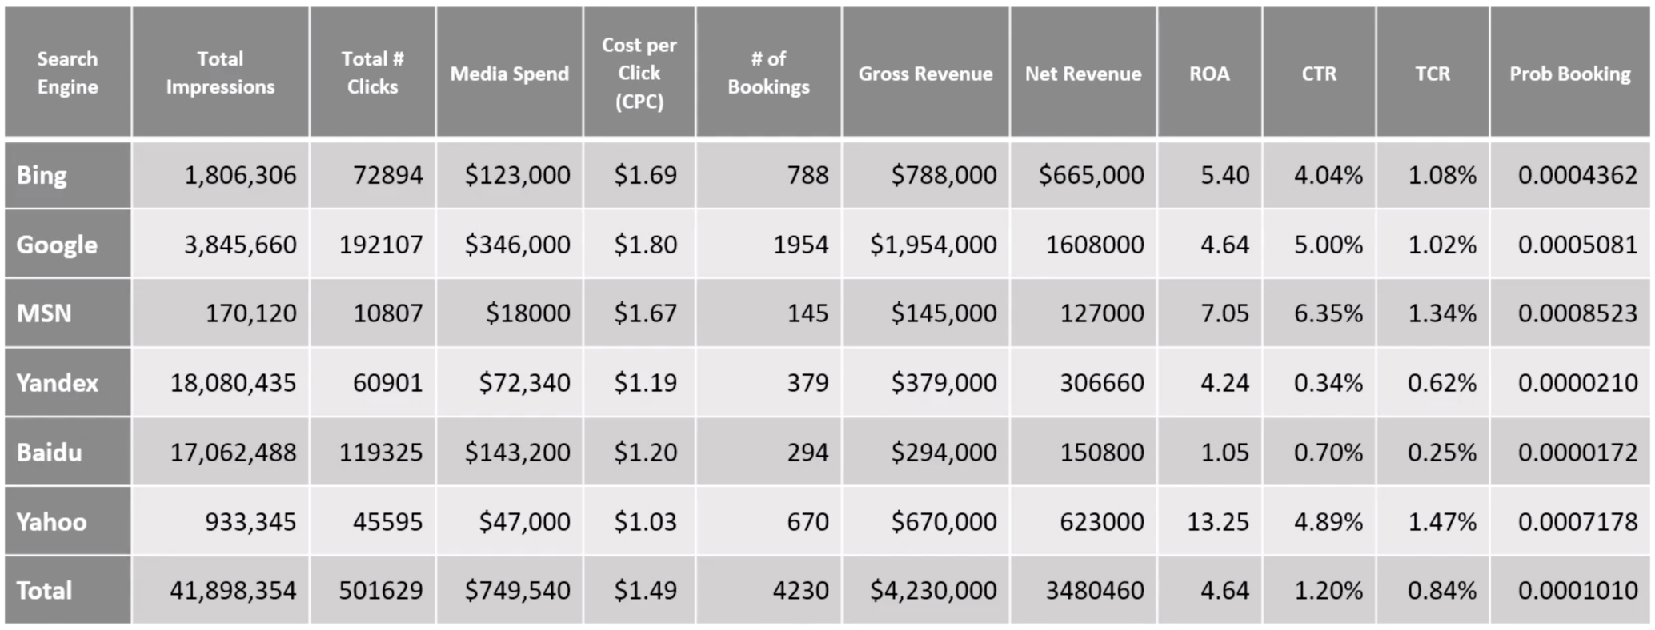
Compare ROIs across Channels
The same ROI calculation can be done at the keyword level within a specific search engine
Automated bidding algorithms take these ROI figures into account to make their bids across keywords
Similar ROI calculations can be done across search, email, display ads etc. to help with allocating budgets across marketing instruments

Slide 57
SEARCH ENGINE OPTIMIZATION
OUTBOUND MARKETING
Notes:
Getting customers come through your website through search engines without paying for it seems like a much better option but it takes work.

Slide 58
SEO
Google Ads (Paid)
Organic
Results (Unpaid)
% Attention Received based on Rank
Sponsored Links
1 | 21.3%
2 | 8.2%
3 | 6.1%
Organic Links
1 | 32.9%
2 | 10.6%
3 | 8.8%

Slide 59
How to Achieve Top Organic Rankings?
Search Engine Optimization (SEO)
Title Tag
Meta Description and Keywords Tag
Header Tags: H1, H2, H3
Image File Names and Alt Tags
Diverse Keywords
Relevancy
Links that are Reputable
Don’t expect quick results!
It takes consistent work to move up the ranks.

Slide 60
DISPLAY ADVERTISEMENTS
OUTBOUND MARKETING

Slide 61
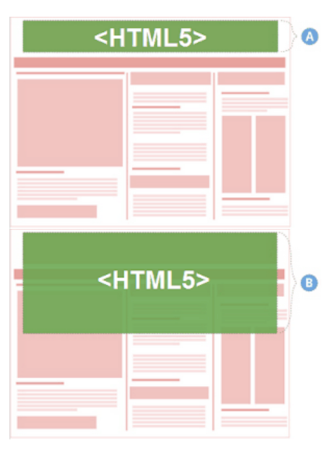
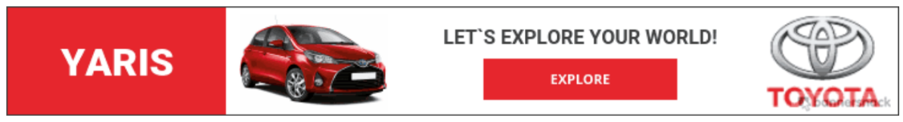
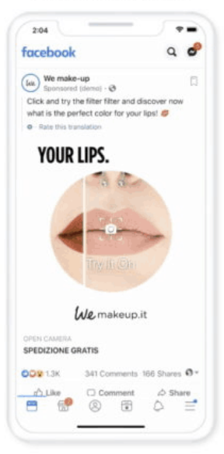
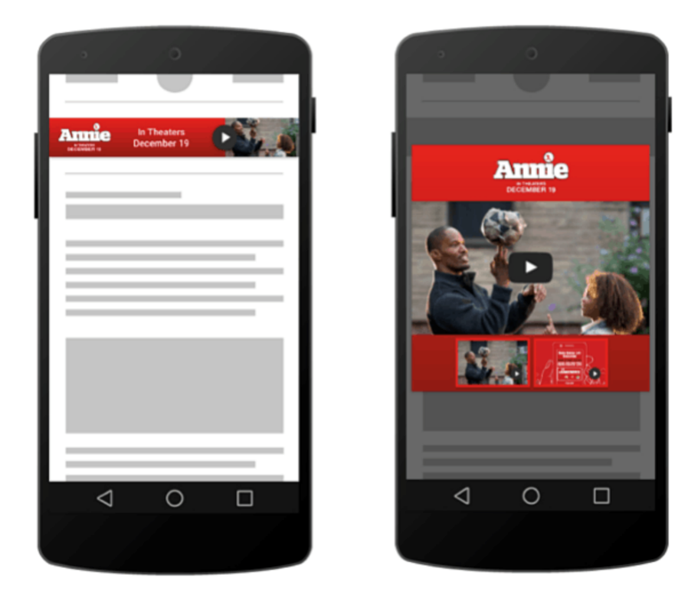
Types
Expandable Ads (Rich Media)
Static Banner Ads
Interactive Ads
Lightbox Ads

Slide 62
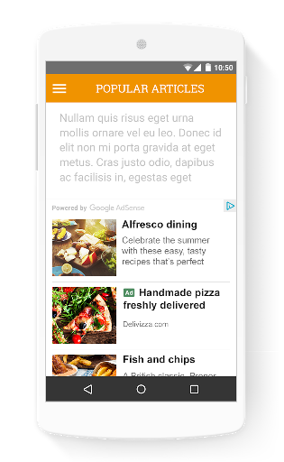
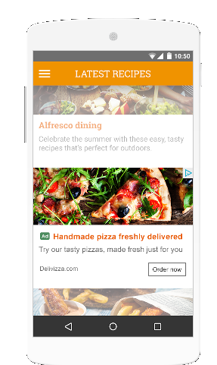
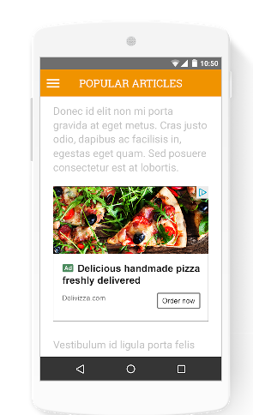
Native Ads with AdSense to Grow Publisher Revenue
Matched Content
In-feed Ads
In-article Ads

Slide 63
US Native Ad Revenue ($ Billions)

Slide 64
The Goal of Display Ads Might Differ
Brand Advertising
Performance Advertising
Loyalty
Advocacy

Slide 65
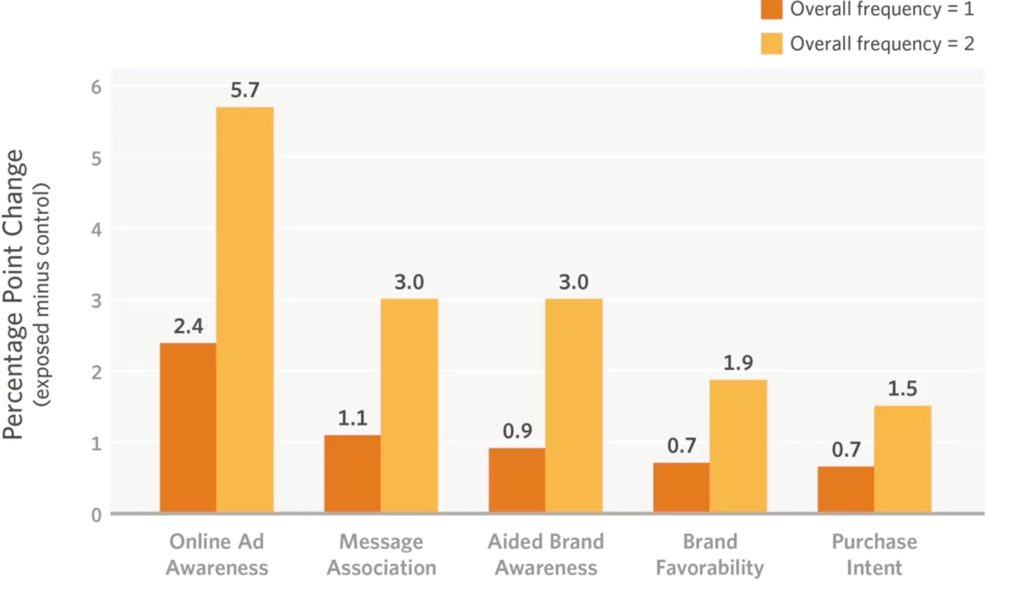
Source: Millward Brown Digital

Slide 66
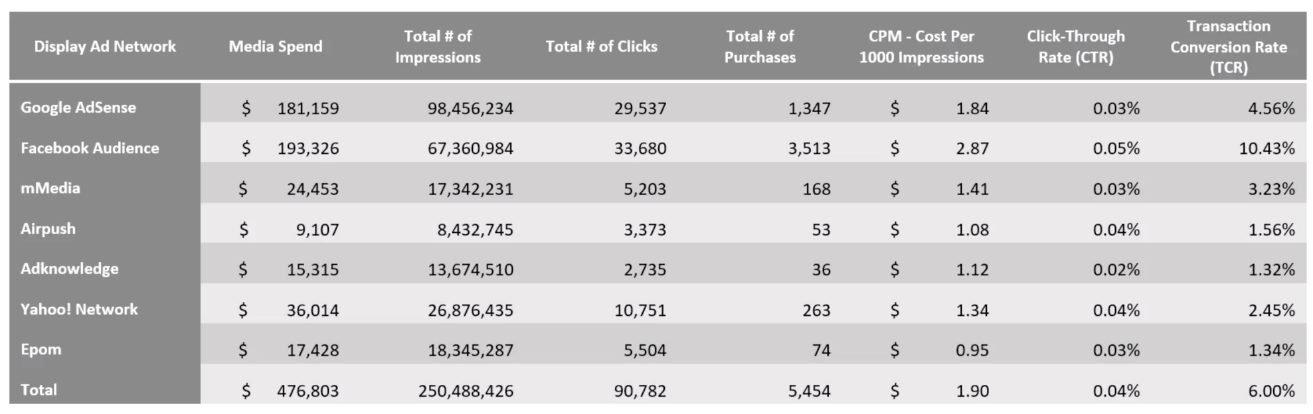
Measuring Display Effectiveness

Slide 67
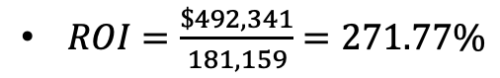
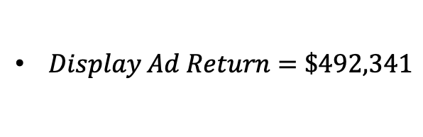
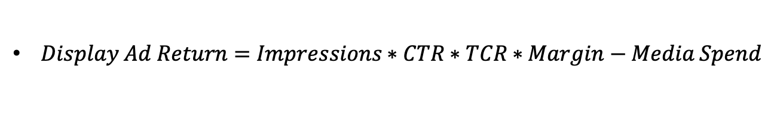
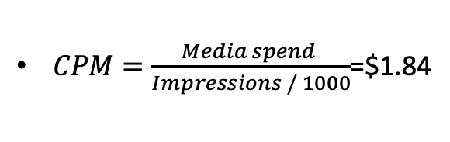
Measuring Display Effectiveness
$CPM=\frac{Media spend }{Impressions / 1000}$=$1.84
$Display Ad Return=Impressions∗CTR∗TCR∗Margin−Media Spend$
$Display Ad Return=\$492,341$
(Assume $500 for margin)
$ROI=\frac{\$492,341}{181,159}=271.77\%$

Slide 68
MULTI-SIDED PLATFORMS

Slide 69
Expanding the Framework
Platform
Social & Mobile
Outbound
Firms
Consumers
Inbound

Slide 70
Multi-sided Platforms
An intermediary between participants
Platform is a business that facilitates the
value-added interactions between different user groups
Value created for all participants during interactions
Multiple user groups

Slide 71
Power of Platforms: Network Effect
PLATFORM
Network Effect
More sellers attract more buyers
More buyers attract more sellers

Slide 72
More on Network Effects
Cross-side network effect (+)
PLATFORM
Same-side network effect
User reviews (+)
Word-of-mouth (+)
Improvement in the recommendation system (+)
Switching cost (+)
Competition (-)
Same-side network effect
Word-of-mouth (+)
Competition (-)

Slide 73
Multi-sided Platforms are Ubiquitous
LET’S THINK ABOUT THE PROBLEM OF LAUNCHING A NEW PLATFORM:
Chicken-and-egg conundrum of platform competition

Slide 74
Strategic Approach to Launching New Platforms
Several strategies have been proposed and implemented in practice for the chicken-and-egg conundrum.
Concentrate your resources on one side (i.e. buyer or seller) to create critical mass there, which serves as a competitive advantage for the entrant
Similar to 1, but instead of the volume of the user group, focus on the engagement of the core user group. How?
Piggyback on another platform’s success and take advantage of their existing user base. Example: PayPal’s spike in growth after its deal with eBay.
Bowling pin approach: Focus on a niche market where the chicken-and-egg problem is relatively more easily overcome. Once the user base has reached a certain level, the platform can then roll out to serve a broader market.
Money burning approach: Intensive advertising and large-scale events to convince potential sellers and buyers of quality in advance (i.e. signaling).

Slide 75
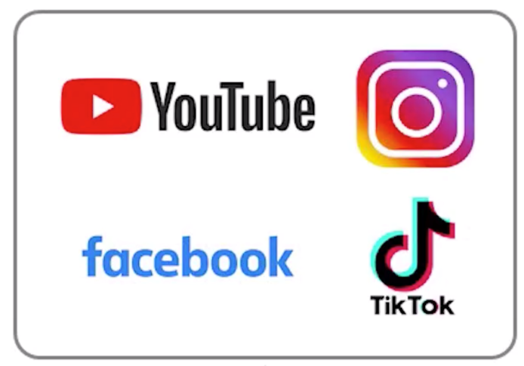
MSPs: The Users
To understand how the platform business model works, we start by asking this important question: who are the primary users on the platform?
When the platforms serve primarily two groups of users, we call them “two-sided” platforms.
Platforms can also serve more than 2 groups: Multi-sided (e.g. social media)
Content Consumer
Content Creator
Advertiser

Slide 76
What Value do Platforms Bring?
Platforms offer two key advantages to the business landscape
Removing the gatekeeper, platforms facilitate direct interactions between consumers and sellers, resulting in increased efficiency
Their ability to serve large numbers of consumers and sellers simultaneously, enables economies of scale on both the demand and supply sides. This is thanks to the network effects on platforms
Notes:
Pipeline Retailer vs. Platforms

